Slide 1
Sports Analytics Group Name TBD
Meeting 1

Slide 2
Primary Goal: Provide us with a creative outlet to get better at statistics through applying statistics to topics we love (sports)…and possibly make some money while we do it

Slide 3
Possible Outlets:
Website/blog devoted to sports analytics
Predictive modeling for sports wagers
Publishing in academic journals

Slide 4
Sports Website – The Mathletic
Main Ideas
Leverage methods in academic papers to create sports content. Two types of content:
General content: Once a basic model is in place, it should be easy to run the model and talk about the results.
Specialty content: Ideally, general content should not take long to produce. Specialty content is spare time work dedicated to a project of your interest.

Slide 5
Sports Website – The Mathletic
General Content:
Power Rankings
Game Predictions
Playoff/Championship Likelihood
Ranking player’s value
Fantasy projections/rankings
Win probability during game
Also General but probably farther out:
Historical rankings of teams and players

Slide 6

Sports Website – The Mathletic
Title Inspiration: The Athletic
Subscription based sports site
Focused on bringing a local sports section feel to a non-local audience
Multi-million dollar operation with some big name writers.

Slide 7
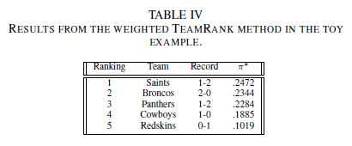
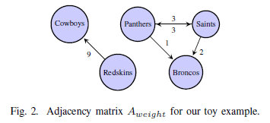
What I’ve been up to: Power Rankings
Loosely based on “A network-driven methodology for Sports Ranking and Prediction” Xia et al (2018)
Uses the basic form of Google’s PageRank algorithm to rank teams.

Slide 8
What I’ve been up to: Power Rankings
Big issues with Xia et al
Dumb way of handling dangling nodes
Only considers a team’s wins
Fixes
Fixed dangling node issue
Create a network model for wins and one or losses and weight them

Slide 9
2017 Power Rankings
Team | Wins | Losses | Strength
MIN | 13 | 3 | 0.180
PHI | 13 | 3 | 0.059
PIT | 13 | 3 | 0.053
NE | 13 | 3 | 0.049
NO | 11 | 5 | 0.048
LAR | 11 | 5 | 0.045
CAR | 11 | 5 | 0.043
JAC | 10 | 6 | 0.039
KC | 10 | 6 | 0.038
ATL | 10 | 6 | 0.037
LAC | 9 | 7 | 0.035
SEA | 9 | 7 | 0.032
CHI | 5 | 11 | 0.029
BAL | 9 | 7 | 0.026
DAL | 9 | 7 | 0.024
DET | 9 | 7 | 0.023
Team | Wins | Losses | Strength
TB | 5 | 11 | 0.022
SF | 6 | 10 | 0.022
GB | 7 | 9 | 0.022
BUF | 9 | 7 | 0.021
MIA | 6 | 10 | 0.018
ARI | 8 | 8 | 0.016
WAS | 7 | 9 | 0.016
NYJ | 5 | 11 | 0.016
CIN | 7 | 9 | 0.015
TEN | 9 | 7 | 0.014
OAK | 6 | 10 | 0.013
DEN | 5 | 11 | 0.012
IND | 4 | 12 | 0.011
NYG | 3 | 13 | 0.010
HOU | 4 | 12 | 0.008
CLE | 0 | 16 | 0.006

Slide 10
What I’ve been up to: Power Rankings
Other functionality
We can weight wins higher than losses
Momentum factor
Games farther out have less weight
Desired improvements
Figure out how to weight previous season into early season rankings

